Slide 1



Economic Viability of Semi-Urban Communities

Slide 2
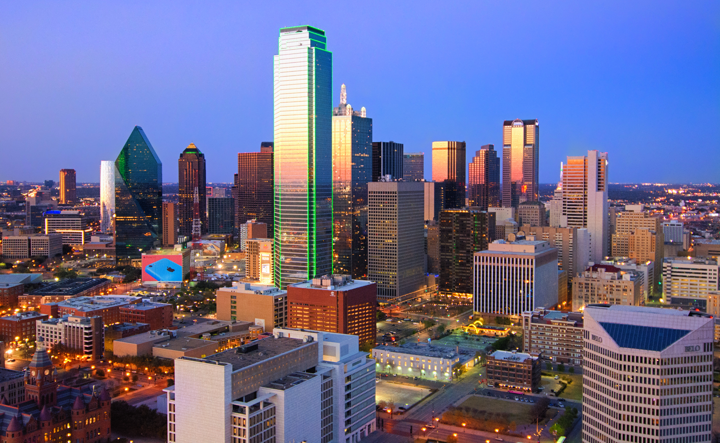
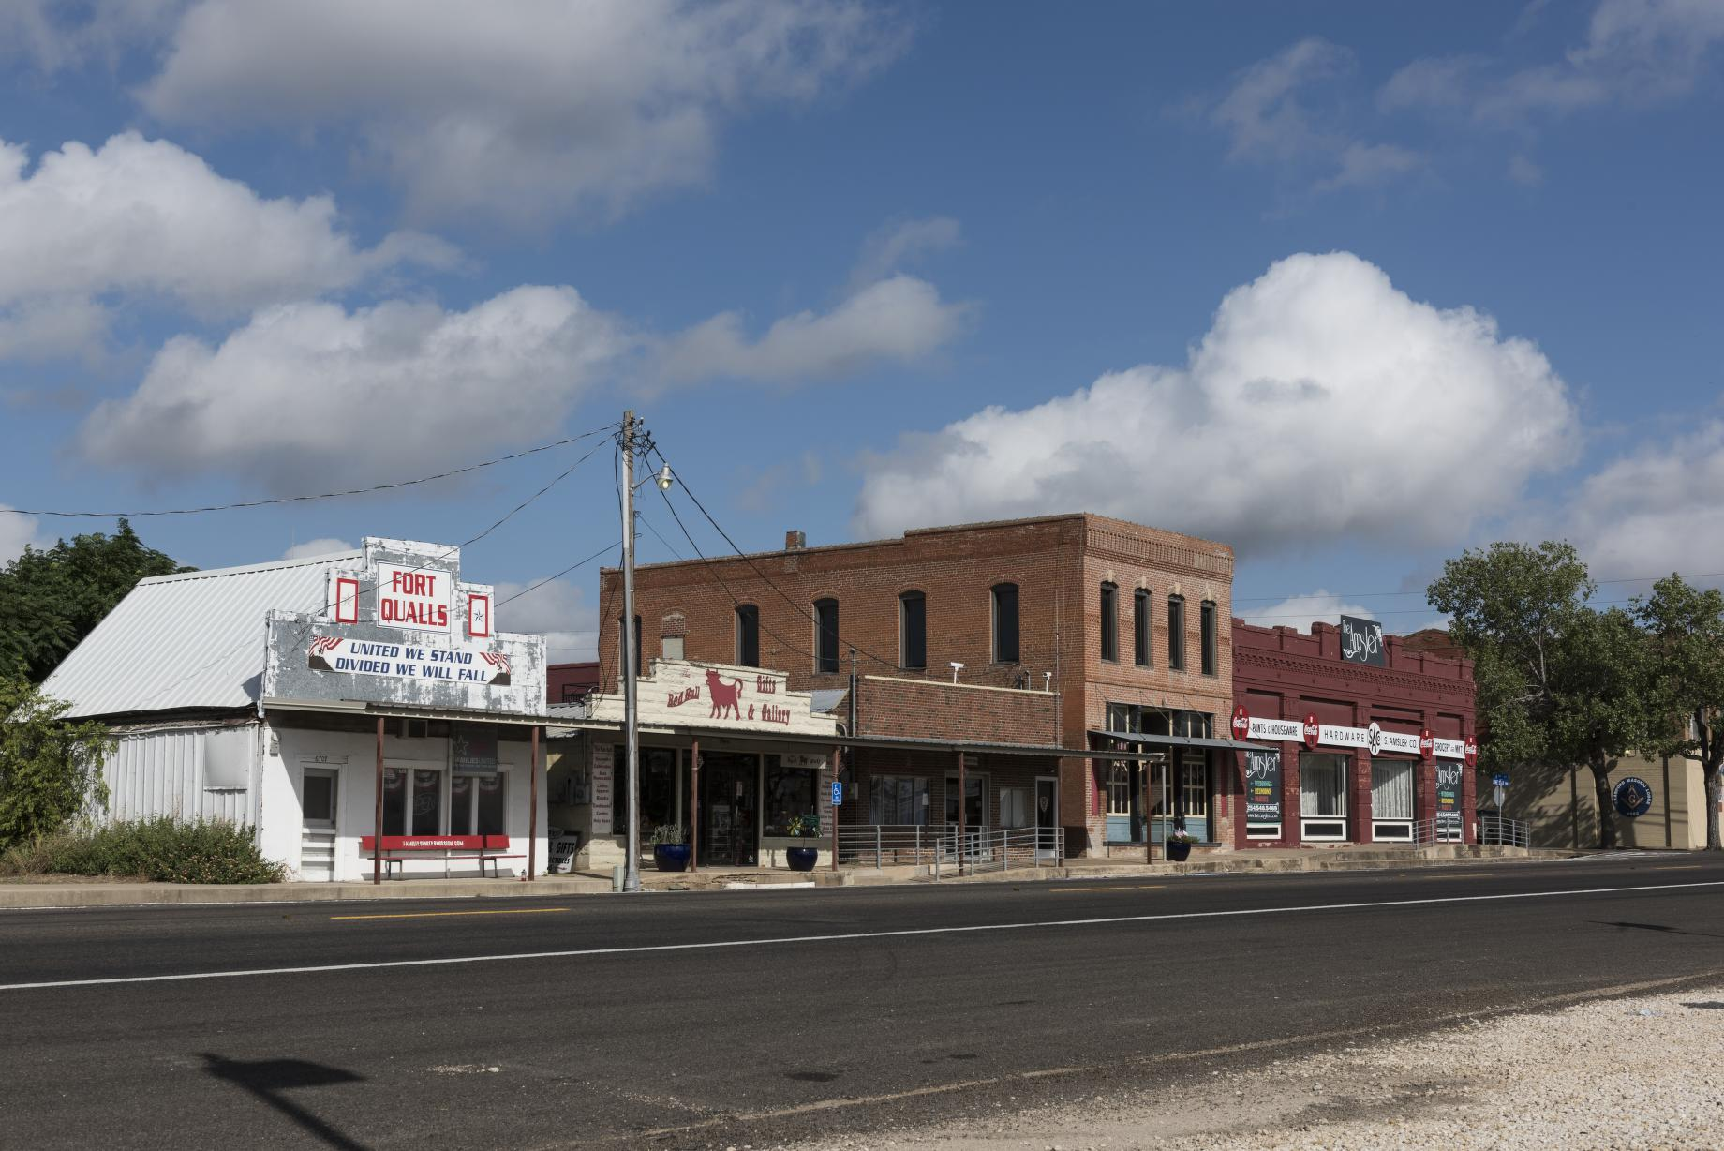
A LONG-STANDING TREND:
Metropolitain Areas Grow
Rural Areas Stagnate/Shrink

Slide 3
OUR QUESTION:
Will greater high-speed internet access,
alternative downtowns, and hybrid work,
create greater opportunities for liminal cities?

Slide 4
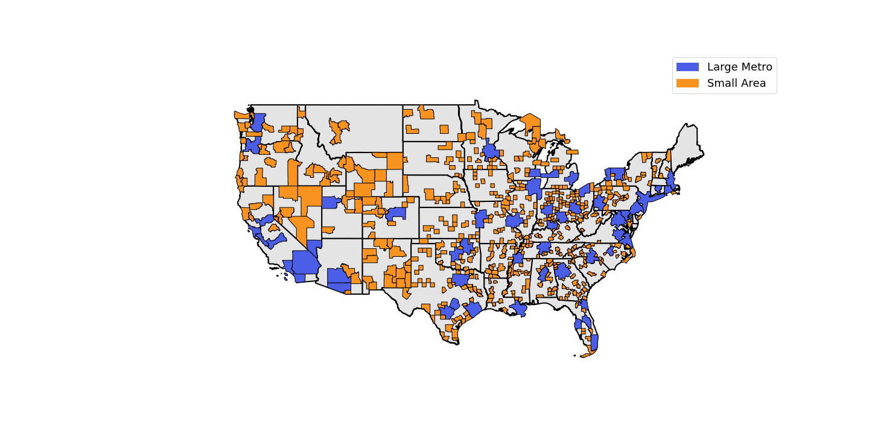
What are "Liminal Cities"?
Small cities (population < 100k)
*Cities are represented by Core Based Statistical Areas as defined by the Census Bureau

Slide 5
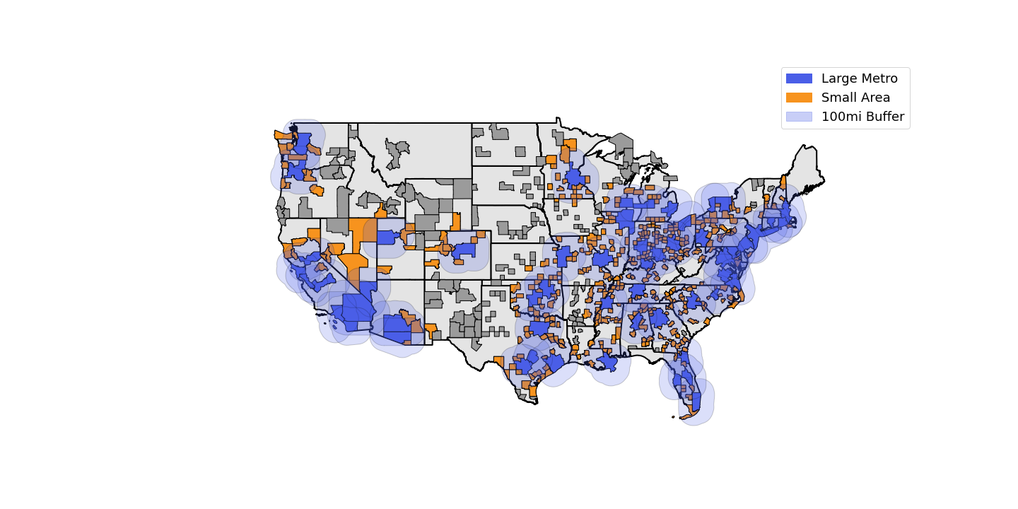
What are "Liminal Cities"?
Small cities (population < 100k)
Close to a large metro (within 100 miles)
*Cities are represented by Core Based Statistical Areas as defined by the Census Bureau

Slide 6

What are "Liminal Cities"?
Small cities (population < 100k)
Close to a large metro (within 100 miles)
With people commuting to metro (> 5% of workers)
*Cities are represented by Core Based Statistical Areas as defined by the Census Bureau

Slide 7
What are "Liminal Cities"?
Small cities (population < 100k)
Close to a large metro (within 100 miles)
With people commuting to metro (> 5% of workers)
*Cities are represented by Core Based Statistical Areas as defined by the Census Bureau

Slide 8
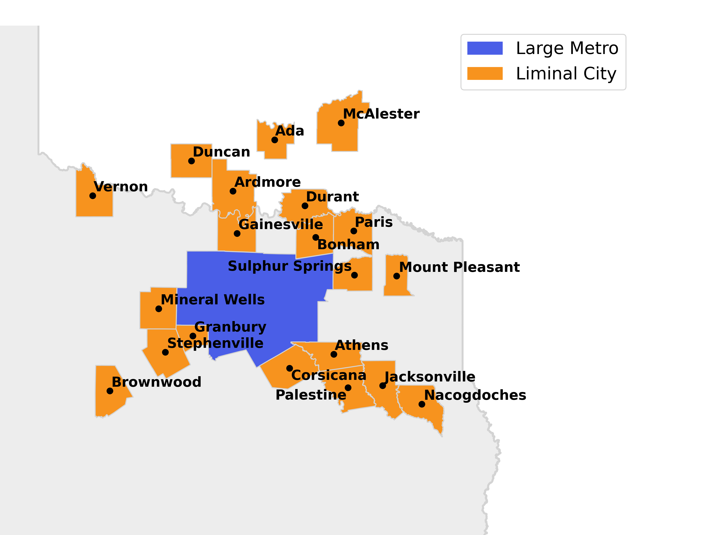
Liminal Cities of the DFW Metro
DFW

Slide 9
Methods
We:
Categorized places as metro, liminal, and micro
Assembled a large variety of datasets for these places
Organized, aggregated, and merged this data by geographic location
Generated a single comprehensive dataset
Produced original visualizations to communicate findings
Data Sources:
American Community Survey
Longitudinal Employer-Household Dynamics
Work From Home Research Survey
Population Estimates Program
Ookla Internet Speed Dataset
Federal Housing Finance Agency
U.S. ParkServe
Environmental Protection Agency
Data Science Tools:
Python
Pandas and GeoPandas
Matplotlib
MainFrame-3
ArcGIS

Slide 10
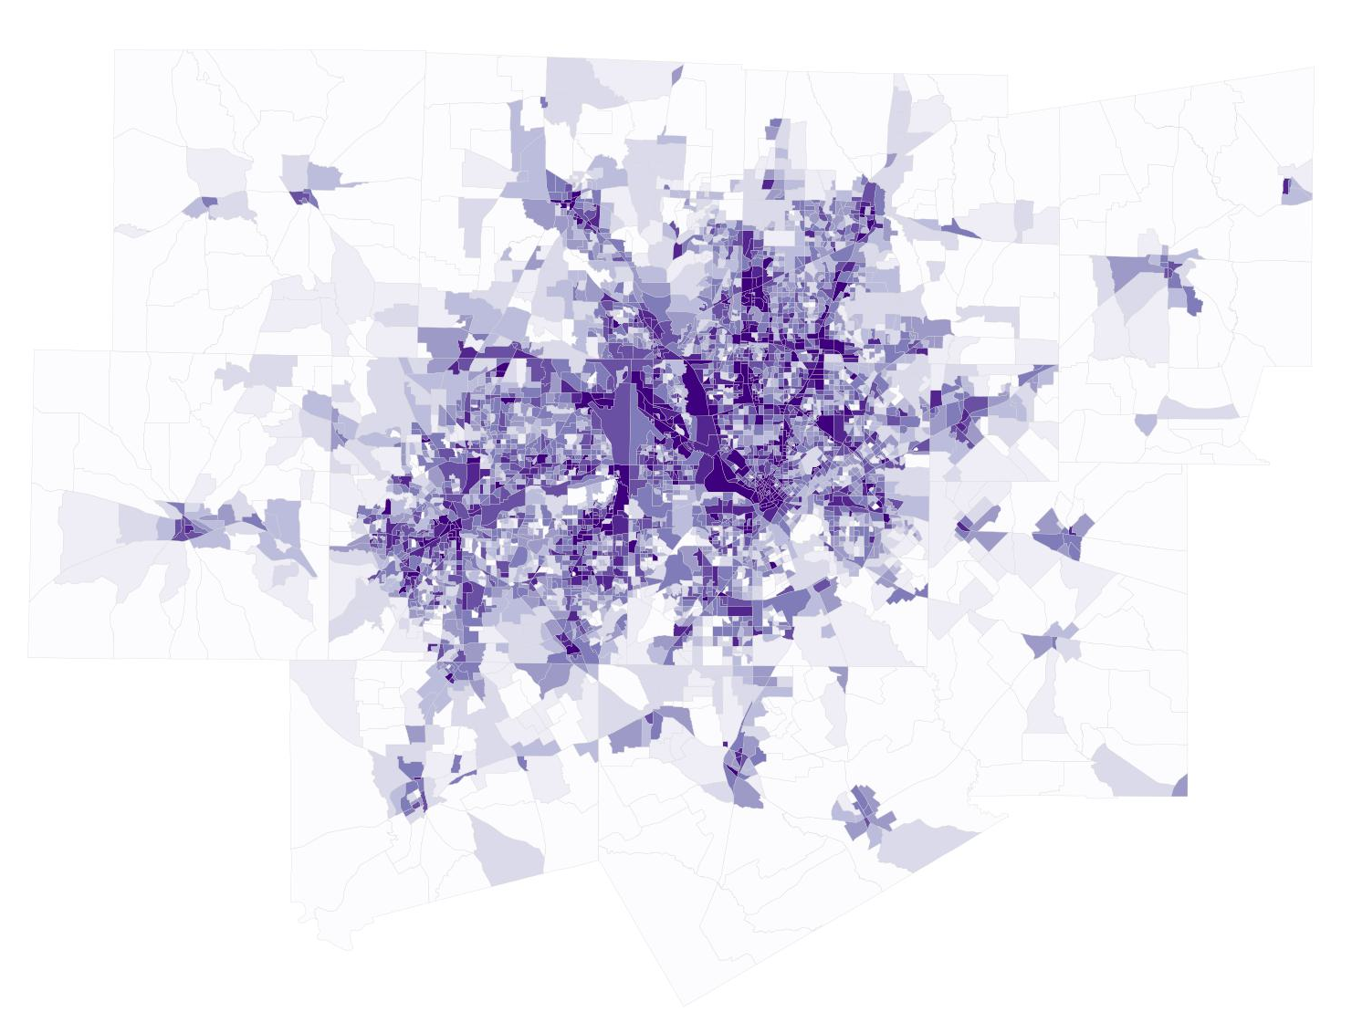
Verifying Premises
Alternative
Downtowns
Traditional
Downtown
Workers/km²
DFW — 2020

Slide 11
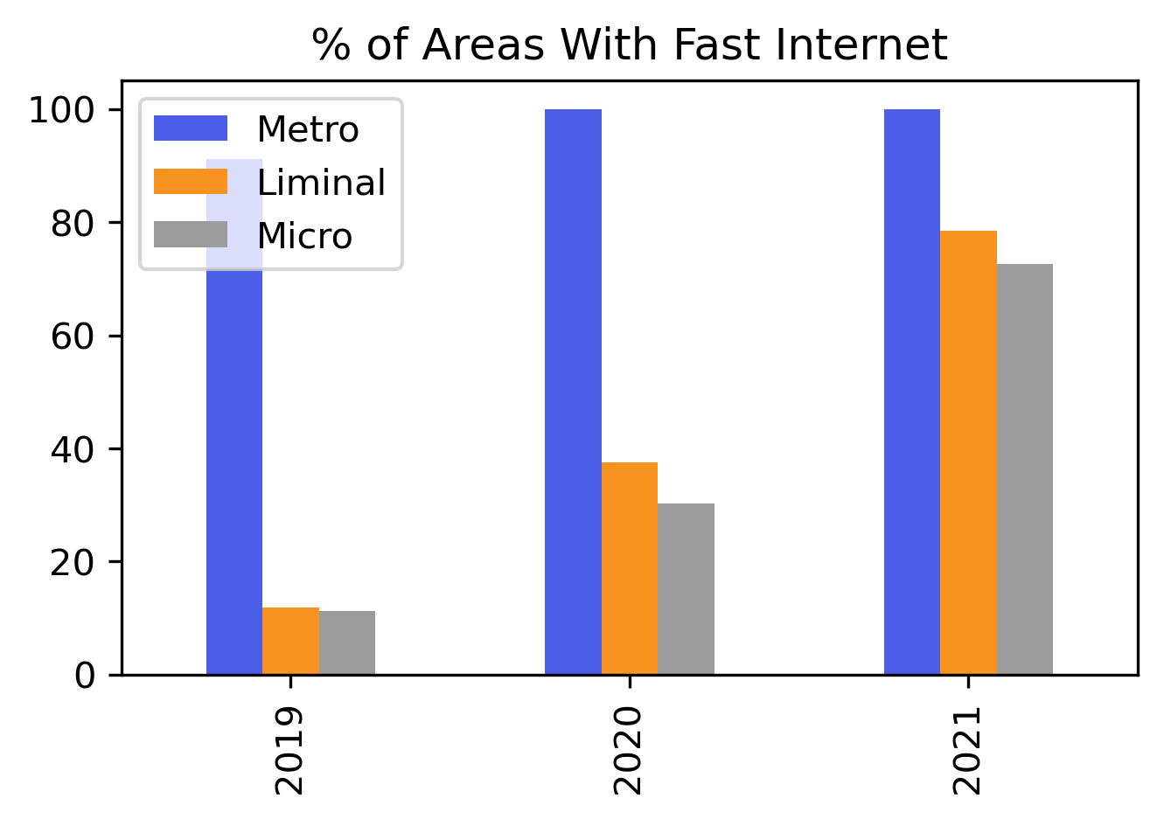
VERIFYING PREMISES
Alternative
Downtowns
Traditional
Downtown
Workers/km²
DFW — 2020
* More than 100Mbps, fast enough for remote/hybrid work

Slide 12
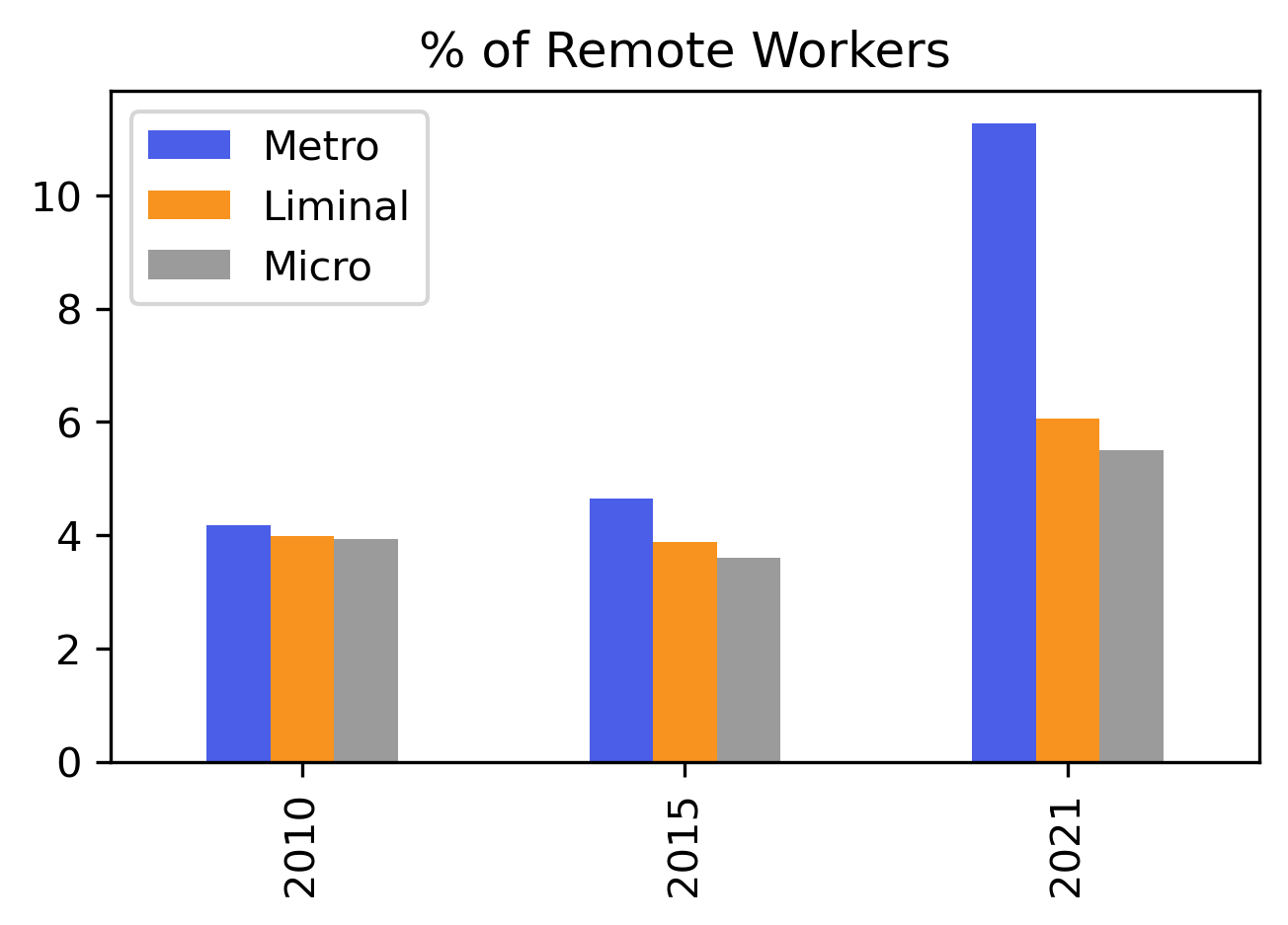
VERIFYING PREMISES
Alternative
Downtowns
Traditional
Downtown
Workers/km²
DFW — 2020

Slide 13
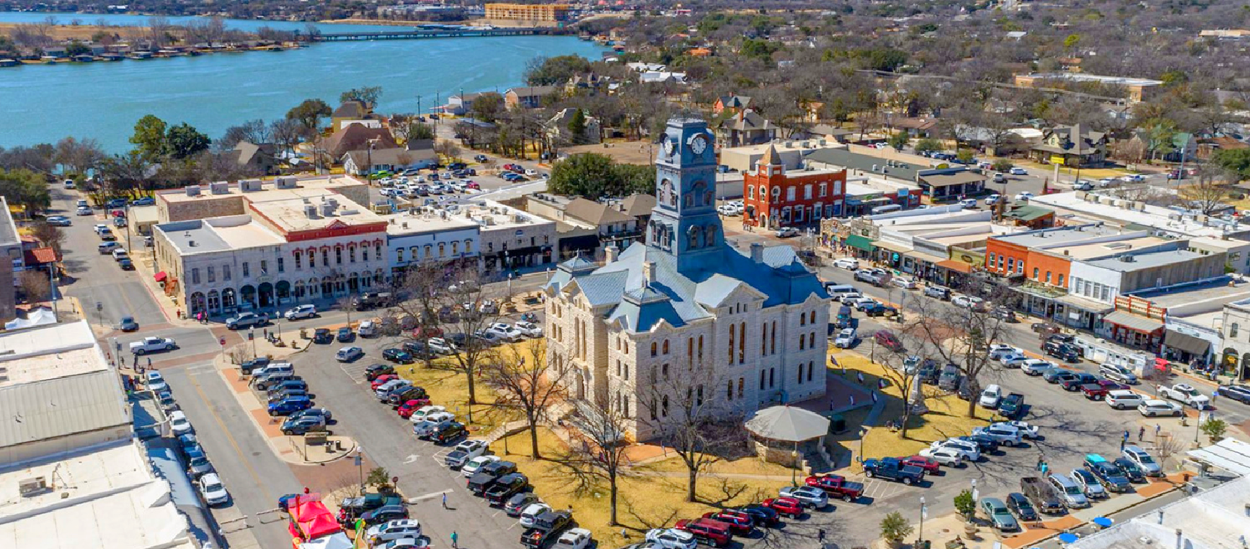
Do these areas have greater opportunities?
and how can we measure growth?
Granbury, TX

Slide 14
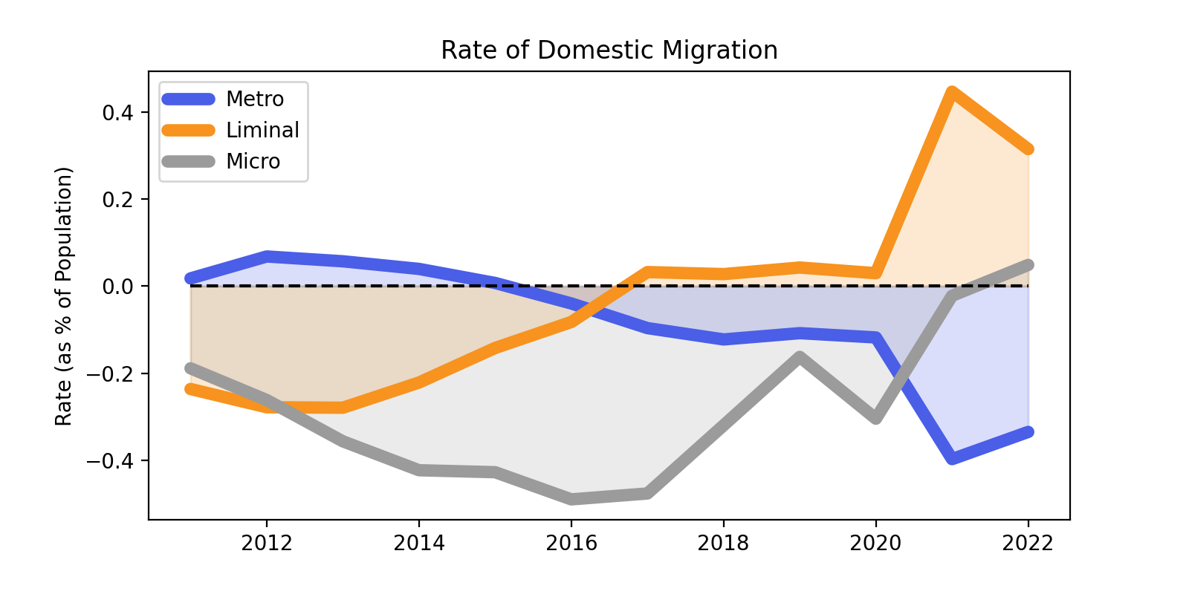
Rate of Domestic Migration
COVID-19
Top Cities in US:
Jefferson, GA
Pahrump, NV
Granbury, TX
Rockport, TX
Prineville, OR
Crossville, TN
Bonham, TX
Fredericksburg, TX
Shelton, WA
Centralia, WA

Slide 15
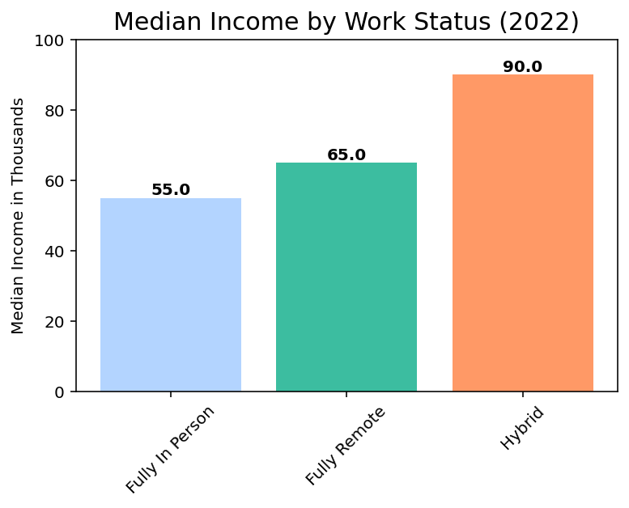
Monetary benefit of living near a metro

Slide 16
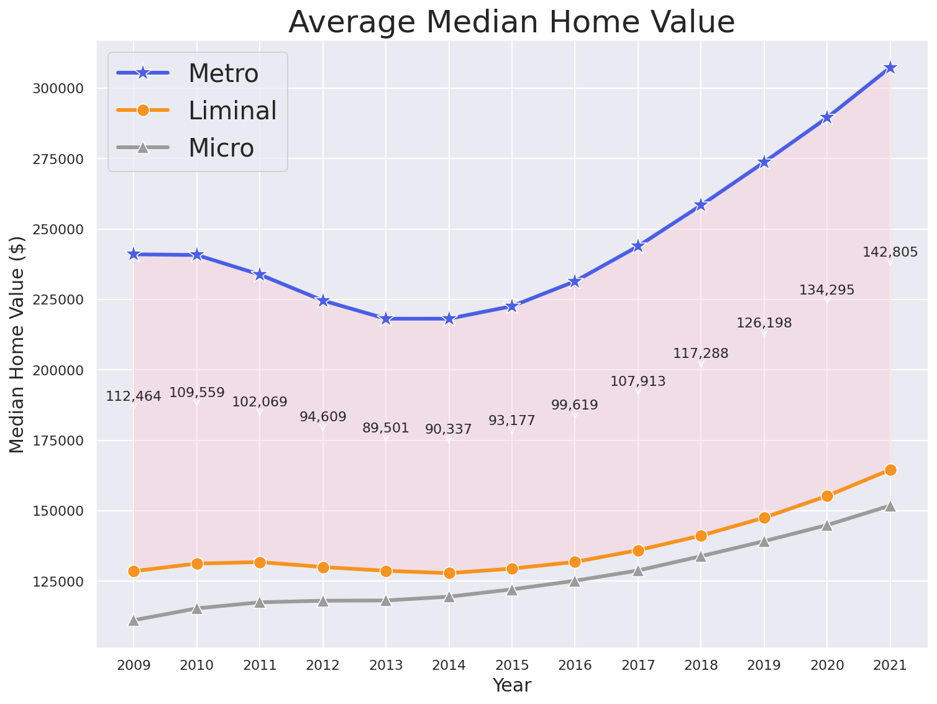
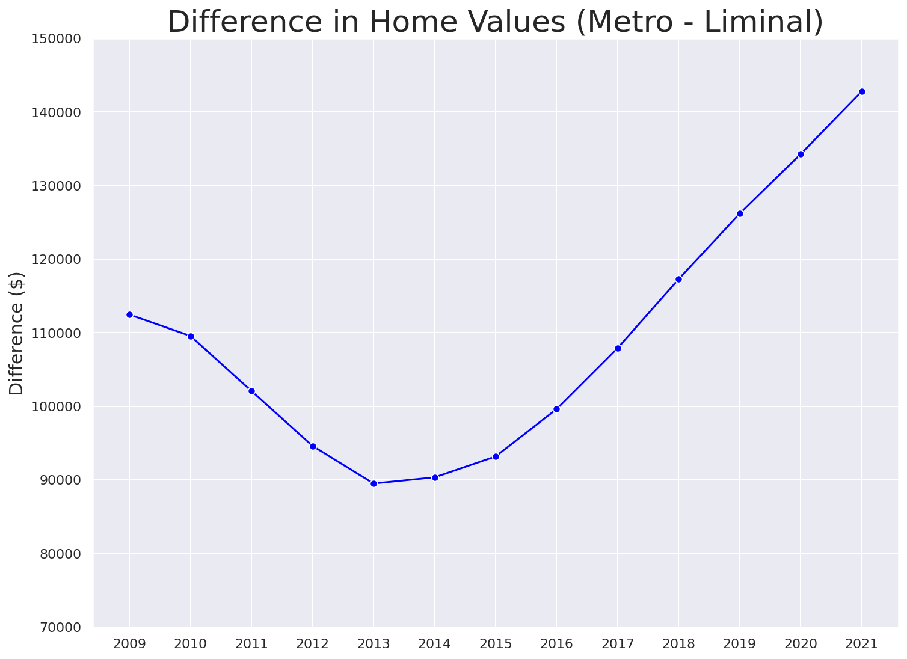
Monetary Benefits of living outside of metros increase
Average increase of $8,447 per year since 2015!

Slide 17


Conclusions
National trends indicate greater internet access, increased remote/hybrid work, and alternative downtowns.
Domestic migration to liminal cities has spiked, while metros trend down.
Housing prices remain lower in liminal cities, supporting a growing incentive to purchase outside of large metros.
Proximity to metros remains key for high income hybrid jobs.
Our comprehensive dataset will be available for further research.

